Slide 1


Funnel Analysis MetroCar
Master project with a full user funnel analysis to a car sharing company: MetroCar
Yuran Belane

Slide 2
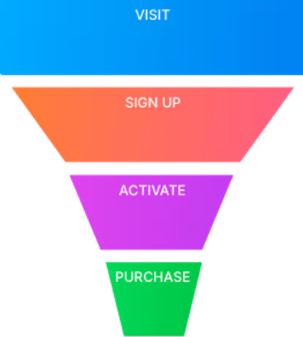
Report overview
Project Overview: Funnel Analysis for Metrocar
Objective: Identify and Improve Key Funnel Stages
Duration: January 2021 - December 2021

Slide 3
Funnel Analysis User Level Funnel Insights:
App Download: iOS dominates with 14,290 downloads.
Sign-Up: Focus on 35-44 age group; highest ride requests (70.68% conversion).
Ride-Completed: Lowest conversion at 50.77%, suggesting optimization opportunities.

Slide 4

Recommendations for Improvement:
User Experience Optimization
Driver Availability and Response
Clear Communication
Incentives for Completion
Prompt Support and Issue Resolution
Gather User Feedback

Slide 5

Platform Focus and Surge Pricing Platform Insights:
iOS: Highest engagement, target through App Store, social media.
Android: Widespread user base, target through Play Store, targeted ads.
Web: Lower downloads; allocate smaller marketing budget.

Slide 6
Surge Pricing Strategy:
Peak hours at 8-9 AM and 4-5 PM.
Consider surge pricing to balance supply-demand dynamics.
Ensure transparency and sensitivity to customer perceptions.

Slide 7

Age Group Analysis
35-44 age group shows highest interest in app downloads and ride requests.
45-54 and 25-34 also exhibit significant interest.
Tailor marketing efforts based on age group preferences.
Recommendations:
Understand reasons behind age-specific trends.
Focus marketing strategies on demographics with high potential.

Slide 8
Ride Level Funnel Ride Level Funnel Insights:
Ride-Accepted stage has lowest conversion at 64.43%.
Potential challenges in drivers accepting ride requests.
Recommendations:
Evaluate driver availability.
Implement driver incentives for higher acceptance rates.

Slide 9
Conclusion
Recap key findings from funnel analysis.
Emphasize the importance of ongoing monitoring and optimization.
Conclude with a call to action for implementing suggested improvements.

